Slide 1
Estimating saturation level of Food Venues in NYC
Project by Sanzhar Shaimerdenov for IBM Data science professional certificate

Slide 2
A problem appears
How do I choose the best spot for my new Point of sale?
We can you Data science instruments to suggest, what kind of spots we should be closely looking at, because they don’t have enough similar kind of Venues nearby to the suggested spot.
Specify the task with assumptions
New-York city is a big and well-known all across the world, it must have a lot of data sources describing it, that we can use to create our model.
Let’s focus on the specific type of Point of Sale – Food Venues (restaurants, cafes, etc.).
Divide New-York city into some manageable amount of areas that we can aggregate our parameters into – and then suggest the potential client to look into some specific area.

Slide 3
Data sources
Project by Sanzhar Shaimerdenov for IBM Data science professional certificate

Slide 4
What kind of data we will be using and merging together?
Goverment
www1.nyc.gov
Neighborhood tabulation
Areas (NTA) shapes, latitude
longitude coords
GeoJSON file
GITHUB
geodacenter.github.io
Statistical information
On income,
Population age
Working population
Foursquare
api.foursquare.com
Extraction of venues
Categorization of venue
types
NYC open data
data.cityofnewyork.us
Population statistics
Wikipedia
Double-check calculated
Area sizes, population &
Other information
195 NTAs – with the notion of polygon and their location on the map
2010 Population amount and calculate the population density to each NTA
2008-2012 aggregated Various statistical information regarding the people/ households to NTA (about 20 out of 195 had missing stats)
47k Venues – cleansed into 43k Venues.
865 categories aggregated into 10 general types

Slide 5
Feature selection table
Kept features | Dropped features | Reason for dropping features
'popinlabou' | 'Population', 'Area_normalized, sq km','medianinco', 'medianage', 'Population density' | No correlation with the target, created a linear regression, R squared for those estimations were less than 0.05
'popinlabou' | 'labour_coef' | popinlabou - meaning population count that is working, and labour_coef, meaning percentage of working population is correlated to each other, and additing two of them simultaneously wouldn't give any information gain
'Arts & Entertainment','College & University','Nightlife spot','Outdoors & Recreation', 'Professional & Other places', 'Residence', 'Shop & Service', 'Travel & Transport' | 'Event' | Not enough venues under the 'Event'

Slide 6
Exploratory data analysis
Project by Sanzhar Shaimerdenov for IBM Data science professional certificate

Slide 7
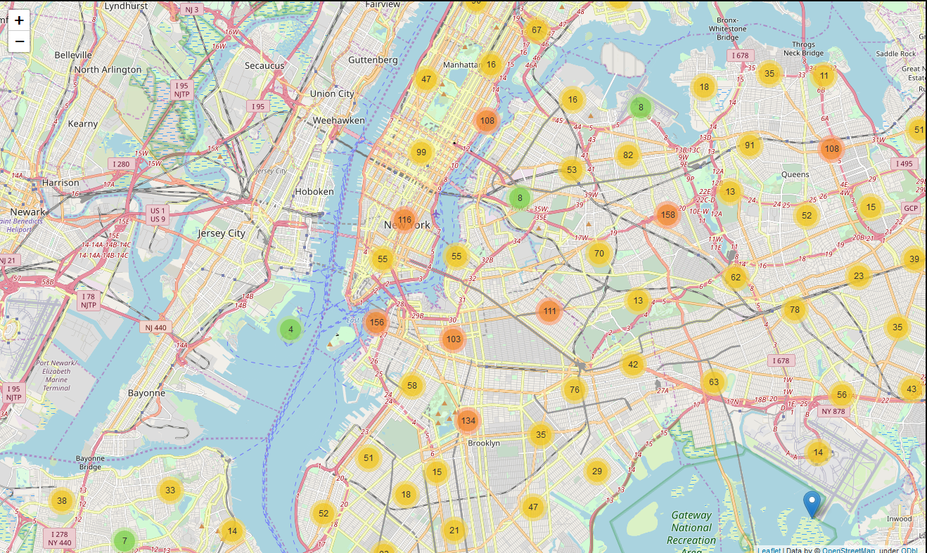
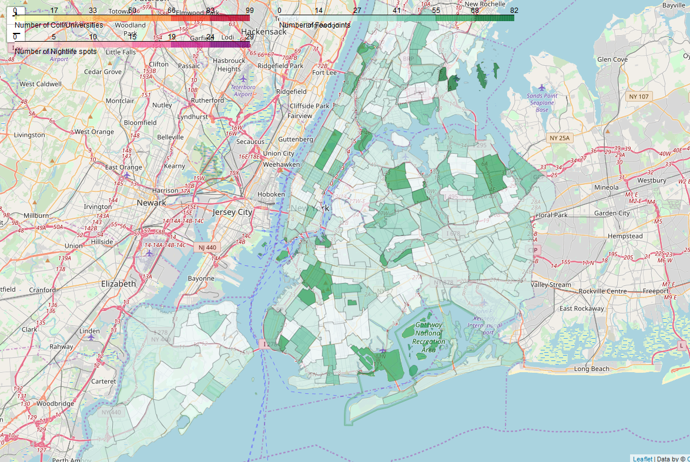
How do we define a target variable?
Venue count aggregated by NYC NTA’s, with the general category ‘Food’

Slide 8
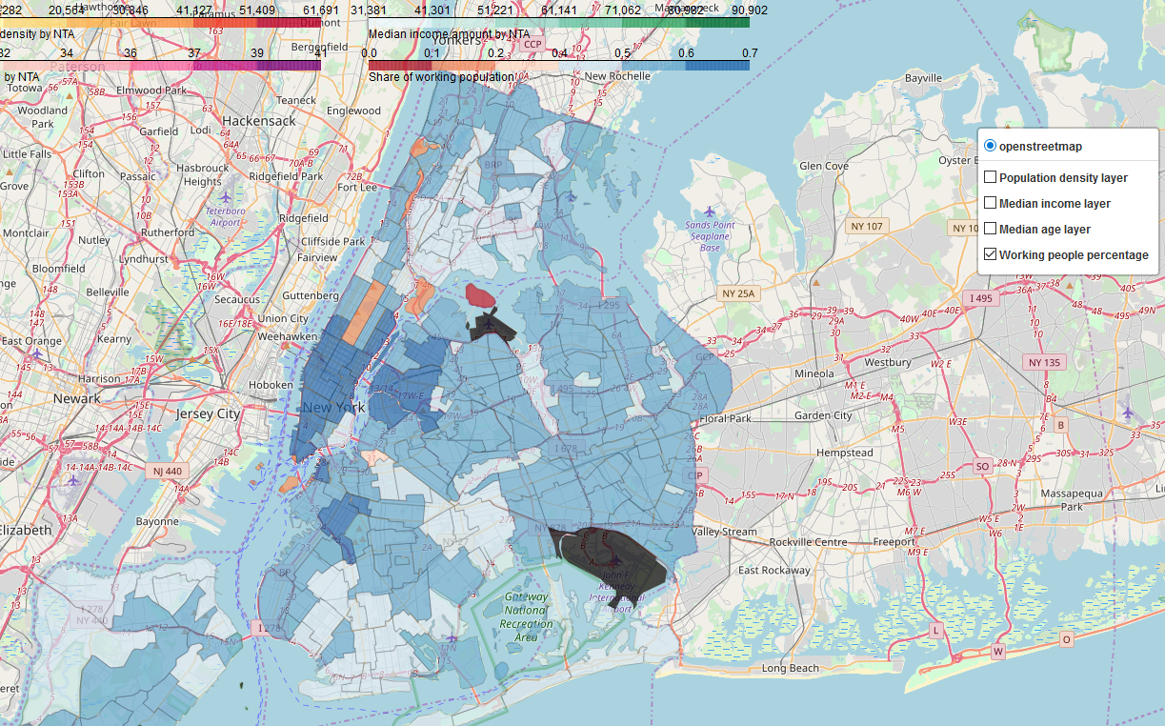
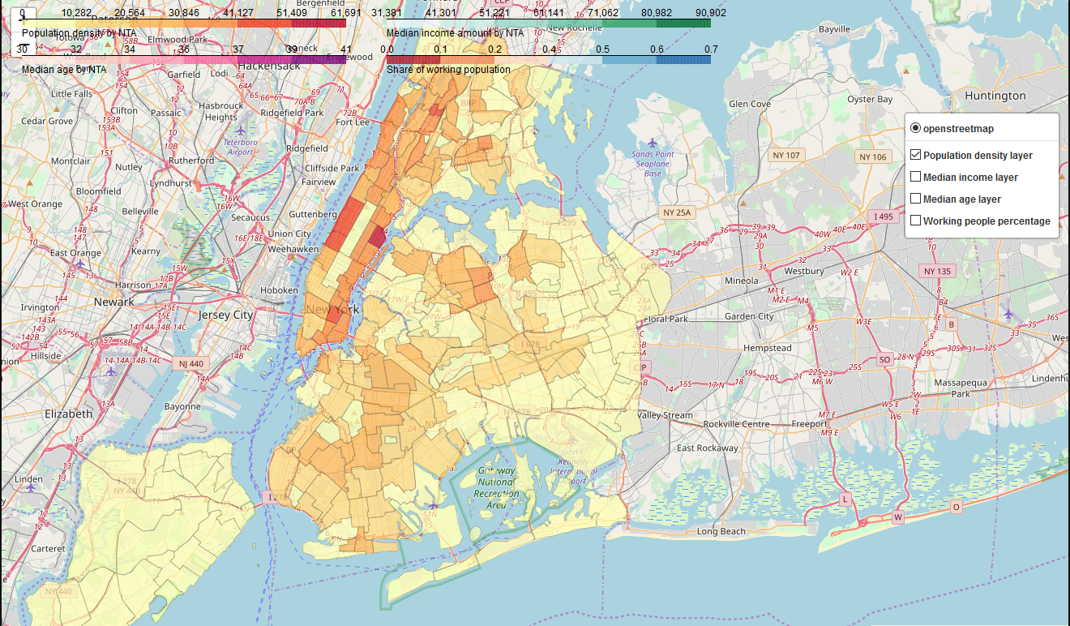
Population statistics by NTA
The information regarding different population statistics, which had been extracted can be shown in jupiternotebook as a multi-layer map

Slide 9
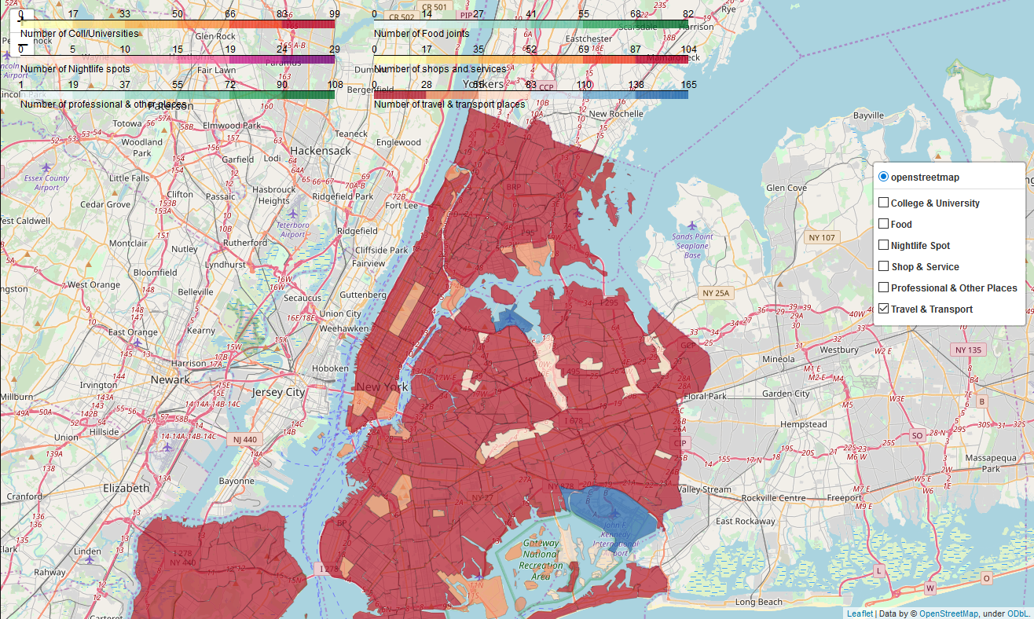
Venue statistics by NTA
The information regarding various general categories assigned to each neighborhood tabulation area (NTA)
You can check out that fully dynamic multi-layer map in attached jupiternotebook - https://github.com/Lovecraft-hp/Data_science_pile/blob/master/Final_capstone_IBM_DSP%20-%20part2.ipynb

Slide 10
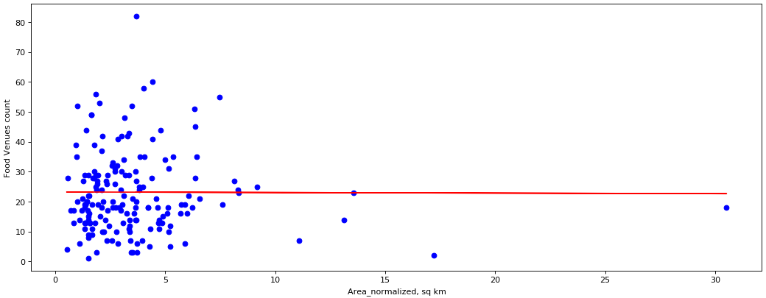
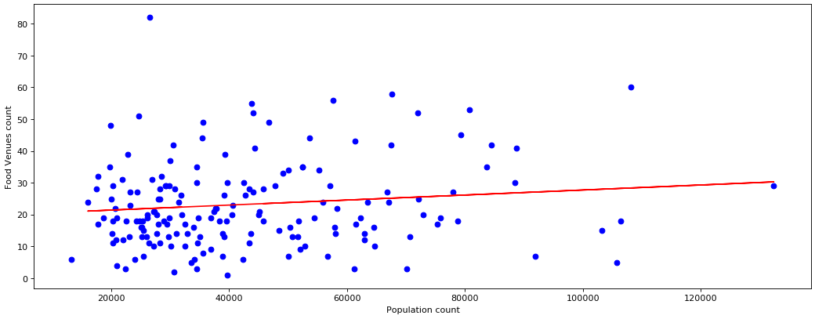
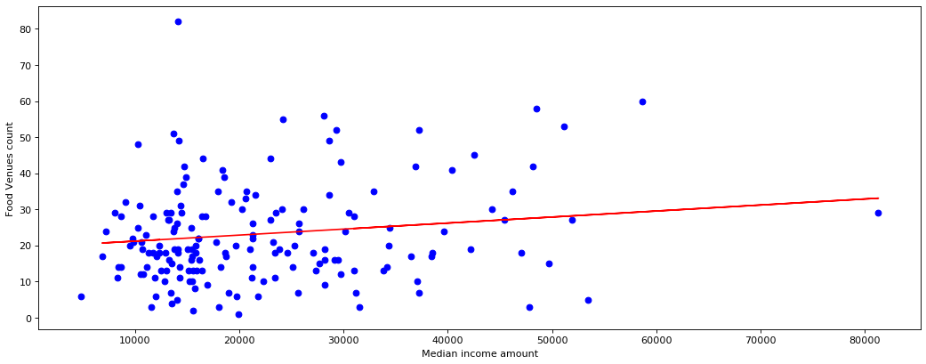
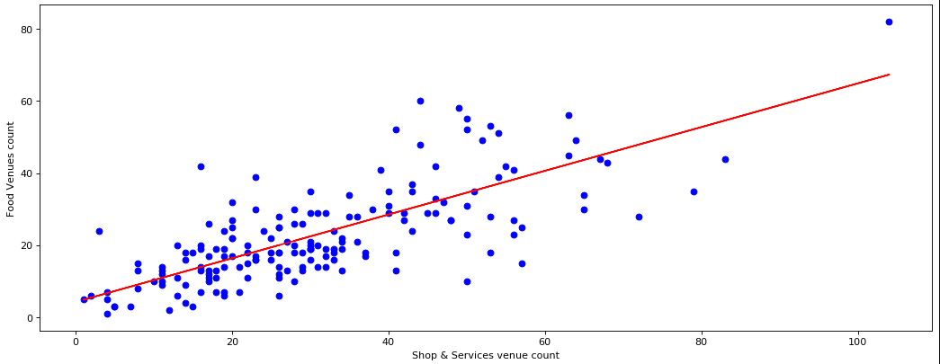
Relationship between target and parameters
Area size normalized, sq km, linear regression coefficient=-0.019, R squared=-0.03 (dismissed)
Population count, linear regression coefficient=0.0001, R squared=0.04 (dismissed)
Median income amount, linear regression coefficient=0.0002, R squared=0.08 (dismissed)
Shop & Services venue count, linear regression coefficient=0.6065, R squared=0.45

Slide 11
Predictive modeling
Project by Sanzhar Shaimerdenov for IBM Data science professional certificate

Slide 12
Regression models comparison
Linear model ‘Nightlife spot venues’ - R squared is equal to 0.16 mean squared error (MSE) is equal to 152.42
Linear model ‘Shop & Service venues’ - R squared is equal to 0.36 mean squared error (MSE) is equal to 115.48
Multilinear model - R squared is equal to 0.42 mean squared error (MSE) is equal to 105.92
Ridge regression (best with poly=2, alpha=200,000,000) - R squared is equal to 0.44 mean squared error (MSE) is equal to 101.18
K-fold multilinear regression (k=4) - R squared is equal to 0.52 mean squared error (MSE) is equal to 84.98
Based on the presented data – we will be using K-fold multilinear regression for our prognosis creation.

Slide 13
Conclusions & Future directions
Project by Sanzhar Shaimerdenov for IBM Data science professional certificate

Slide 14
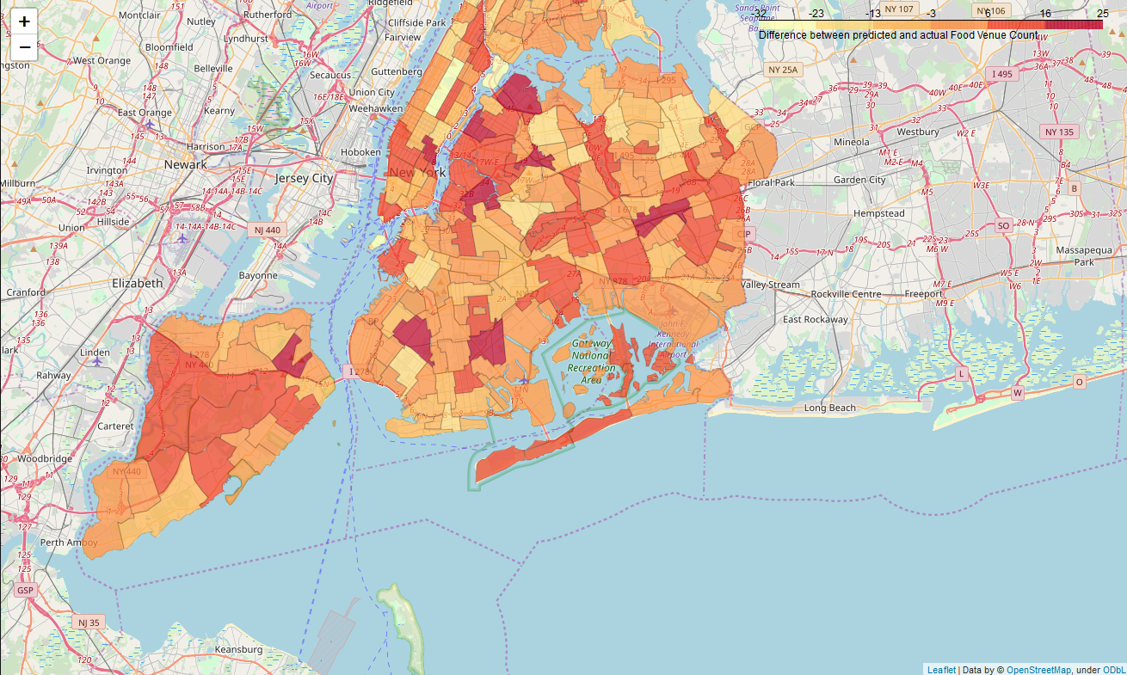
The main idea - use the difference between the actual and predicted food Venue count not as error, but as missed opportunity, probably very under saturated neighborhood we should look into
TOP 10 under saturated NTAs discovered
Also, a map of NYC NTAs with the differences:
NTA Code | NTA Name | Borough | Food Venue Count | Food venues estimate | Venue count diff
QN72 | Steinway | Queens | 14 | 39.48 | 25.48
BK58 | Flatlands | Brooklyn | 10 | 34.20 | 24.20
SI08 | Grymes Hill-Clifton-Fox Hills | Staten Island | 3 | 25.42 | 22.42
BK88 | Borough Park | Brooklyn | 18 | 39.90 | 21.90
BK90 | East Williamsburg | Brooklyn | 6 | 25.87 | 19.87
MN20 | Murray Hill-Kips Bay | Manhattan | 13 | 31.55 | 18.55
QN68 | Queensbridge-Ravenswood-Long Island City | Queens | 5 | 22.29 | 17.29
QN61 | Jamaica | Queens | 16 | 32.89 | 16.89
QN50 | Elmhurst-Maspeth | Queens | 15 | 31.03 | 16.03
MN21 | Gramercy | Manhattan | 17 | 32.73 | 15.73

Slide 15
Future directions – something to think about
We should include the information about population more like – how many people pass through that neighborhood, or street on a daily basis, because how many people actually live in this neighborhood turned out to be useless information.
We can point out, what exact location is the best to place a Food venue in, depending on the distance, count and category of the nearby Venues.
We can also add information on other cities to enrich the data and increase the number of elements.
The final comment for development is on data modelling – we can create an Ensemble model – first to segment similar neighborhoods, and then create specific predictive algorithm tailored for that specific segment.

Slide 16
Thank you!

